Slide 1
Joint Programming in Neurodegenerative Disease Research (JPND) Concluding remarks
27-28 November 2024
Prof. Philippe Amouyel, MD, PhD
JPND Chair
France

Slide 2
JPND / JPco-fuND Symposium Objectives
Showcase and dissemination of up-to-date research achievements of JPND-supported projects to all relevant stakeholders.
Train young scientists from the JPND-funded projects.
Disseminate the results obtained to potential stakeholders
Meeting with industries and the European Stakeholders
To allow an opportunity for networking and knowledge exchange between JPco-fuND projects and other JPND-supported projects, as well as among other conference attendees.
Call 2019, 2020, 2021

Slide 3
JPND 2024

Slide 4
Mechanisms and measurement of disease progression in the early phase
The aim of the call is to establish a number of ambitious, innovative, multi-disciplinary and multi-national collaborative research projects that seek to improve the understanding of disease mechanisms and advancing measurability of disease progression at early and pre-symptomatic stages of neurodegenerative diseases.
Advancements may allow a more accurate identification of pre-symptomatic disease stages, a reliable monitoring of disease progression and paving the way for new therapeutic and preventive approaches.

Slide 5
Call 2024 outcomes
138 pre-proposals and 37 full-proposals submitted
20 projects recommended for funding by peer-review evaluation
10 projects will receive funding
Projects include 49 research groups from 17 countries
Successful: Czech Republic, Hungary, Poland, Slovakia and Turkey

Slide 6
Call 2024 results

Slide 7
JPND 2025

Slide 8
JPND JTC 2025
“Health and social care research with a focus on the moderate and late stages of neuro-degenerative diseases”
Regular call for research projects
Funding duration 3 years
Envisages to fund at least 10 projects

Slide 9
Aim of the call
The aim of the call is to increase understanding of the factors that hamper social inclusion, civic participation, dignity and well-being of patients and their families and to develop more adequate concepts of easily accessible support for people with neurodegenerative diseases at moderate, advanced and end of life stages by, e.g.
Deciphering interplay of biological, environmental, social, economic factors in cognitive decline
Investigating specific/changing needs in different subtypes, trajectories and treatment regiments of NDs
Identifying transition points of deterioration & establish measures for effective interventions/prevention
Establishing effective models of care by studying quality of care
Developing guidelines/harmonization of SOPs for use of socio-cognitive testing across countries in Europe and beyond

Slide 10
Participating agencies/countries
Canada, Canadian Institutes of Health Research (CIHR)
Canada, Brain Canada Foundation (BCF)
Czech Republic, Ministry of Education, Youth and Sports (MEYS)
France, French National Research Agency (ANR)
Germany, Federal Ministry of Education and Research (BMBF)
Hungary, National Research, Development and Innovation Office (NKFIH)
Ireland, Health Research Board (HRB)
Italy, Ministry of Health (MOH-IT)
Latvia, Latvian Council of Science (LCS)
Luxembourg, National Research Fund (FNR)
Norway, The Research Council of Norway (RCN)
Poland, National Science Centre (NCN)
Slovakia, Ministry of Education, Science, Research and Sport of the Slovak Republic
Sweden, Swedish Research Council for Health, Working life and Welfare (FORTE)
Türkiye, Scientific and Technological Research Council of Türkiye (TUBITAK)
Further countries may join until January 5, 2025.

Slide 11
JTC Call 2025 announcement

Slide 12
Timeline
Selection of Full-proposals
Submission deadline
First projects starting
Funding decisions
Call launch
Funding of Consortia (36 months)
Jan.
2025
March
2025
May
2025
Oct
2025
Jan
2026

Slide 13
JPND Working Group 2025 call
“New advanced cellular models”
Developing novel models that are much more relevant to ND and consider factors such as the progressive nature of the disease, comorbidities, sex differences, genetic background and ageing
Patient-derived induced pluripotent stem cells (iPSCs) and organoid culture in the field, including organ-on-a-chip, microfluids and all kinds of enhanced co-cultering or developing high-throughput culture systems (genetic screenings with CRISPR-libraries).
These approaches have the potential to reduce the need for “classical” animal models and cell systems.

Slide 14
New advanced cellular models focus
Reflect the complex and structured interaction of different cell types (“organoids”)
Recapitulate key aspects of the pathology observed in the brain
Allow screening and genetic or metabolic perturbations in a high-throughput format
Allow differential analyses of cellular sub-compartments
Allow multimodal cellular phenotyping
Allow to assess the efficacy and safety of potential therapeutic compounds
Be compatible with co-culture
Possible assembly of various tissues for organoid culture
Possible integration on a chip, with or without microfluidics

Slide 15
New advanced cellular models timeline
Should have been launch in November 2024
Still searching for a national agency to launch the call
JPND 2025 is a transition year

Slide 16
Brain Health 2026

Slide 17
Brain Health Partnership

Slide 18
Brain Health

Slide 19
EP Brain Health Mission and Vision
Vision
Improved brain health for all, developing scientific knowledge as a ground to promote brain health throughout lifetime, to prevent and to cure brain diseases as well as to improve wellbeing of people living with neurological and mental disorders in Europe and beyond.
Mission
To support brain health research and innovation by strengthening transnational collaboration and alignment to enhance understanding of the brain and to promote the translation of results into tailored solutions for prevention, diagnosis, treatment and care accessible for all.

Slide 20
European Partnership for Brain Health
Coordination: Germany (BMBF, DLR-PT)
Expected Participants: National funding authorities, researchers, healthcare providers/practitioners, patient organisations, the private sector, policymakers, regulators, citizens, etc.
Implementation mode: Co-funded European Partnership in the 2nd Strategic plan of „Horizon Europe“ (Cluster 1, Health)
Duration: 7 – 10 years, starting in 01/01/2026

Slide 21
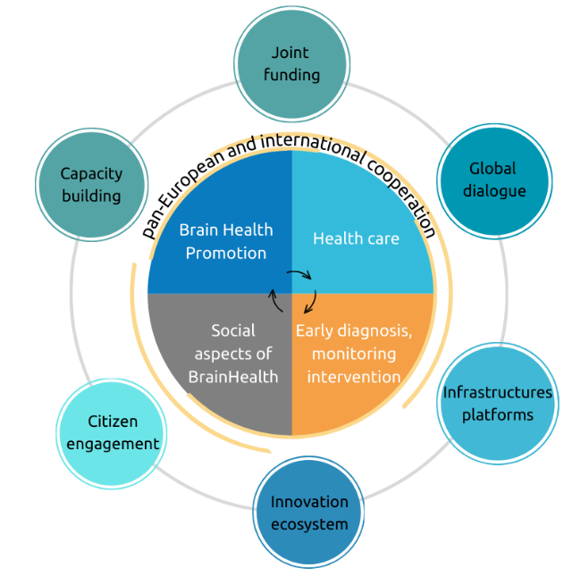
Brain Health Partnership SRIA

Slide 22
EP BrainHealth priorities
Promoting brain health and preventing brain disorders
Improving early recognition, diagnosis, monitoring and intervention for people living with brain disorders
Improving treatment, care and support for people living with brain conditions and their caregivers
Integrating the social, ethical, and legal dimensions to advance research and innovation for brain health
Translation to market
Infrastructures
Data access, quality, reproducibility, harmonisation, standardisation
Involving citizens, patients and caregivers
Ethical, legal, social aspects
New generations of researchers
Tailored interventions for brain health

Slide 23
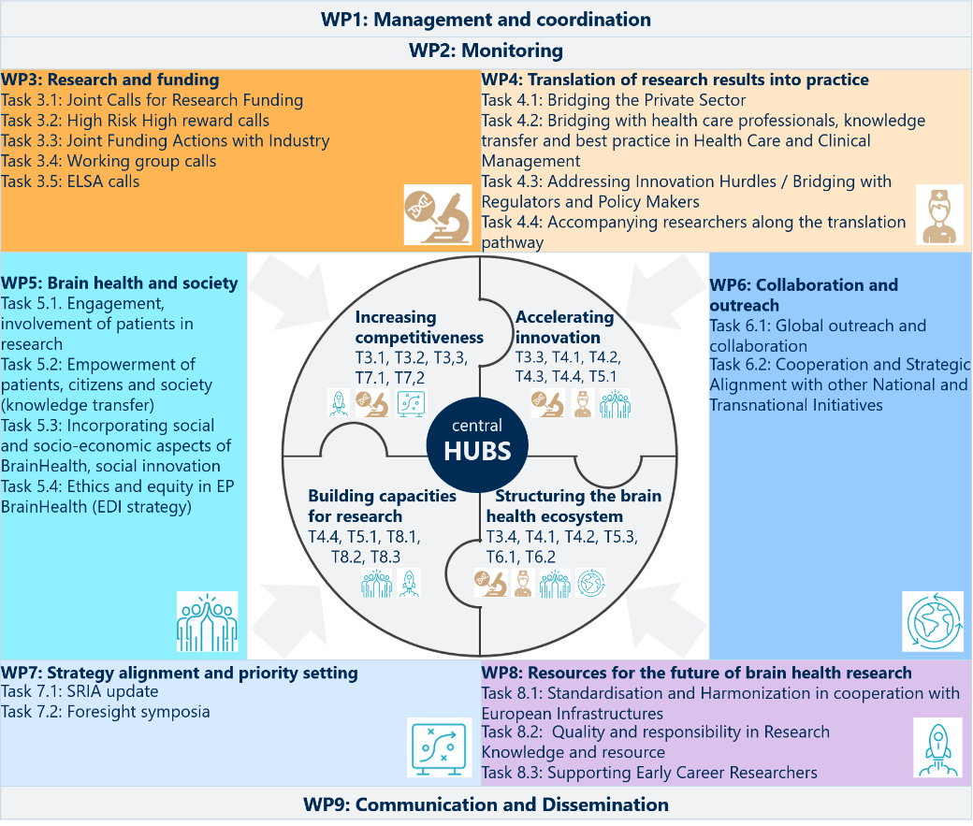
Allocating prioritized activities

Slide 24
EP Brain Health Activities
Capacity building
Advocacy and outreach
Communication and dissemination
Empowerment
Funding
RRI-Open Science
TMRF
Engagement with the scientific community at key conferences
FENS partnering
Foresight symposium
Competitivity
Success stories
SRIA update
Brain to Market School
Industry
Satellite event at BID
Success stories
Accompagnying academics towards innovation
Innovation
INTEGRATIVE HUBS
PPI training
ELSA
Engagement with patients and families webinar
Videos and podcasts
Citizens empowerment workshop
PPI and Society
Mentoring programme
High risk
Engagement with the ECR community at key conferences
Videos
Stipends, awards and prizes
Towards the Future of Brain Health
Brain awareness week
FENS partnering
Science to society workshop
Working group
Open consultation
RI webinars
RI Key person
Ecosystem structuration and extension
Global webinars
FENS partnering
Alignement with other initiatives

Slide 25
BP Brain Health TMRF 2026
“Transnational Multidisciplinary Research Funding”
Targeting the whole « Brain Health » research community

Slide 26
Acknowledgments
Rosalie Nelissen
Gabriëlle Lijten
Inge Sips
Sophie Habets
Cule Cucic
Karin Yeo
Pierre-Olivier Fernagut
Etienne Hirsch
Alexandra Rodrigues

Slide 27
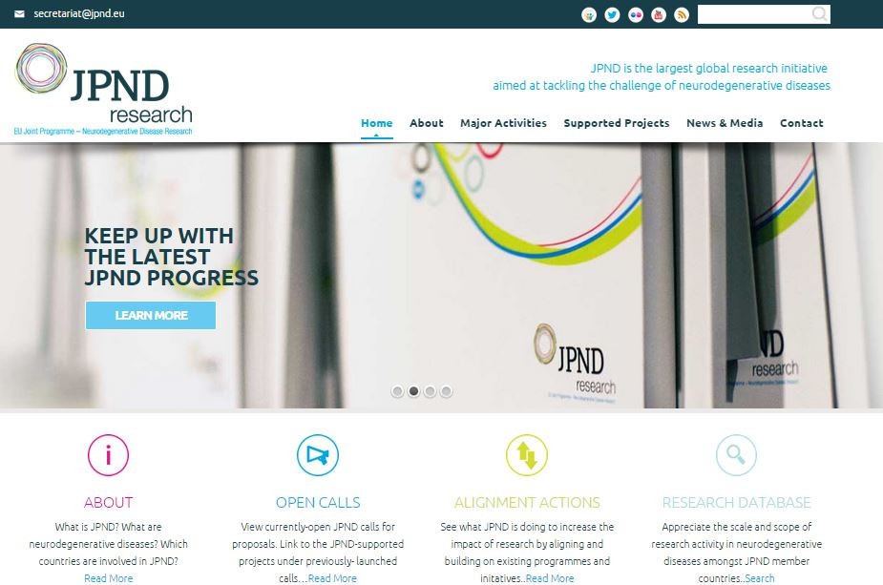
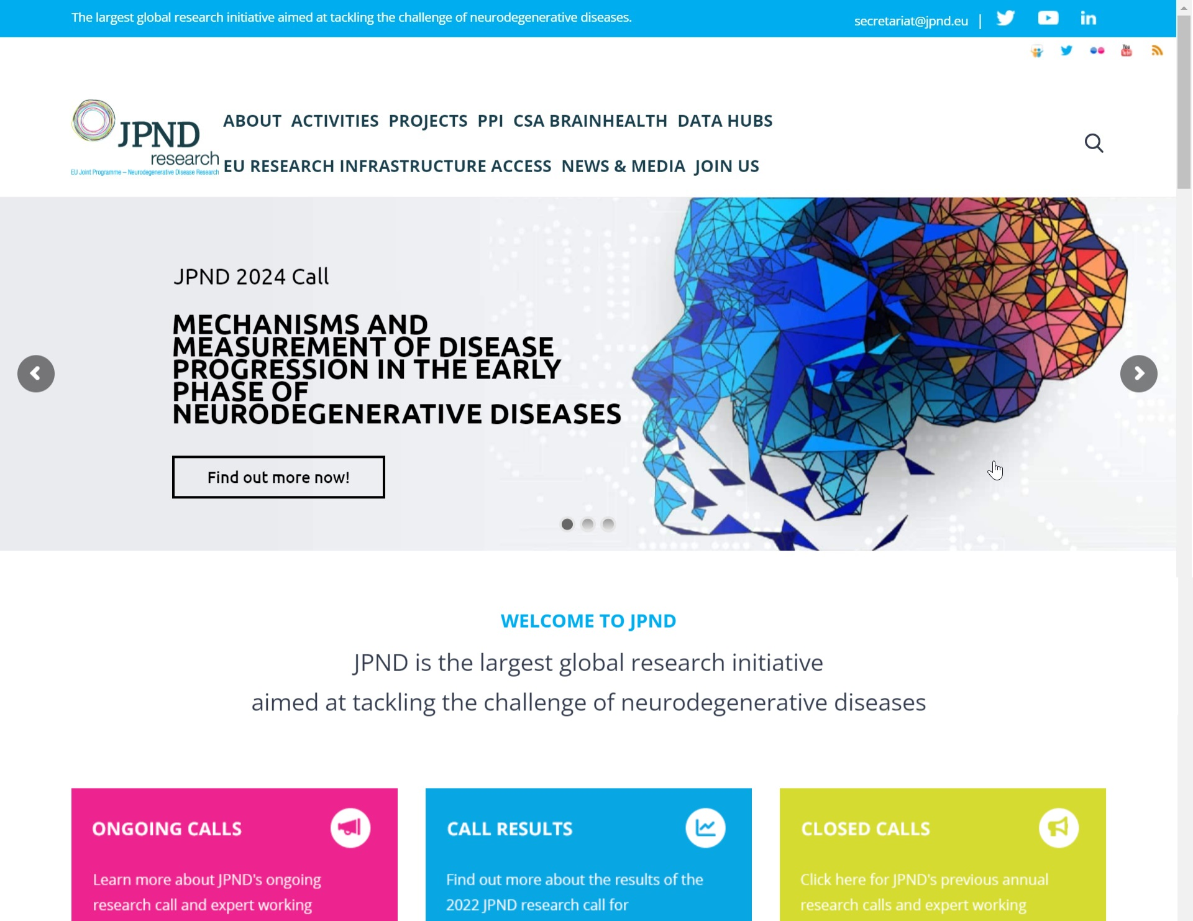
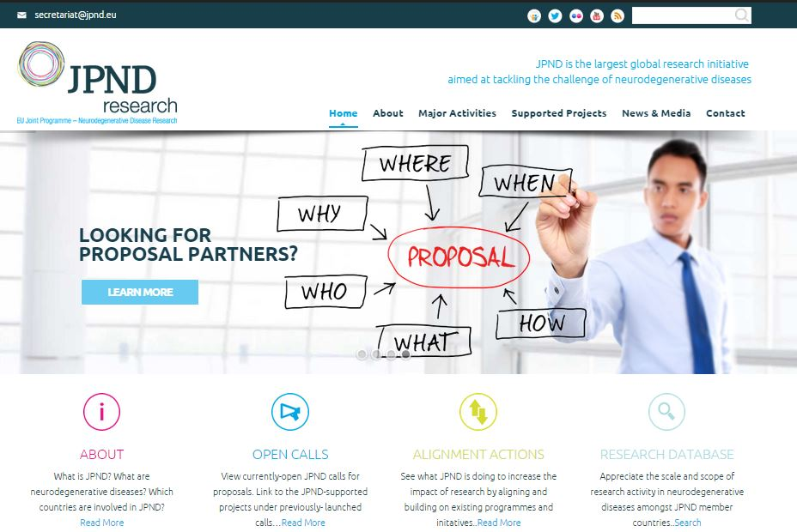
Thank You!
Follow our progress:
Visit the JPND website:
http://www.jpnd.eu
E-mail : secretariat@jpnd.eu
@JPNDEurope
Notes:
Please don’t hesitate to reach out if I can help you with any JPND-related communications needs.
Thank you!

