Slide 1
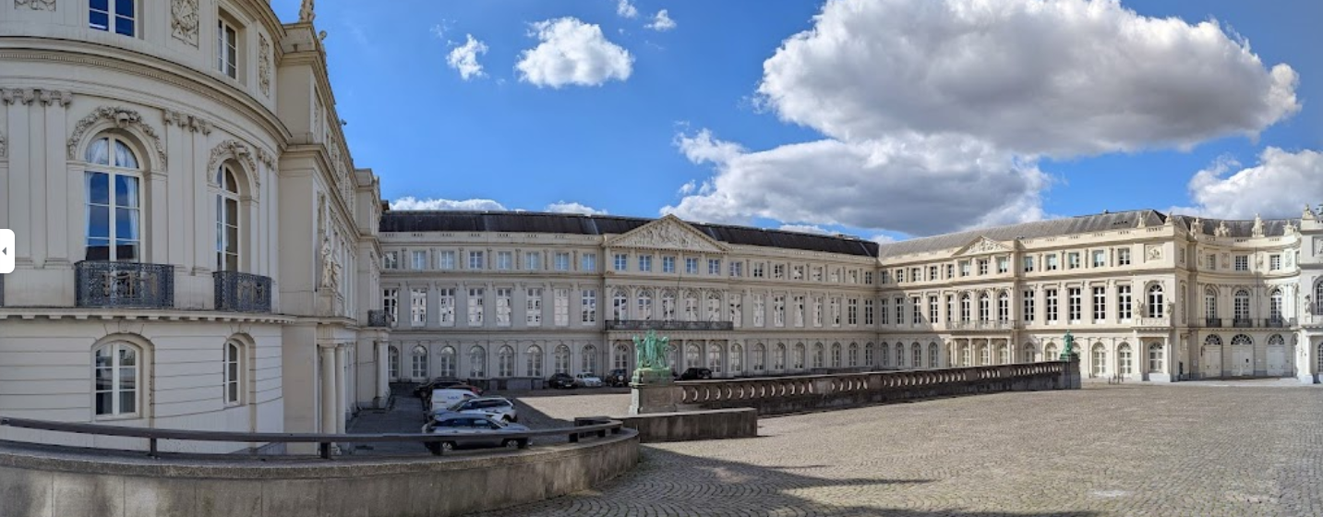
Joint Programming in Neurodegenerative Disease Research (JPND) JPco-fuND2 Final Symposium
27-28 November 2024
Prof. Philippe Amouyel, MD, PhD
JPND Chair
France

Slide 2
JPND / JPco-fuND Symposium Objectives
Showcase and dissemination of up-to-date research achievements of JPND-supported projects to all relevant stakeholders.
Train young scientists from the JPND-funded projects.
Disseminate the results obtained to potential stakeholders
Meeting with industries and the European Stakeholders
To allow an opportunity for networking and knowledge exchange between JPco-fuND projects and other JPND-supported projects, as well as among other conference attendees.
Call 2019, 2020, 2021

Slide 3
The conditions of success
Increase the critical mass of physicians and scientists involved in neurodegenerative disease research
Increase the funding dedicated to neurodegenerative disease research (10x less than in cancer research)
Increase the number of collaborations globally
The largest global research initiative aimed at tackling the challenge of neurodegenerative diseases

Slide 4
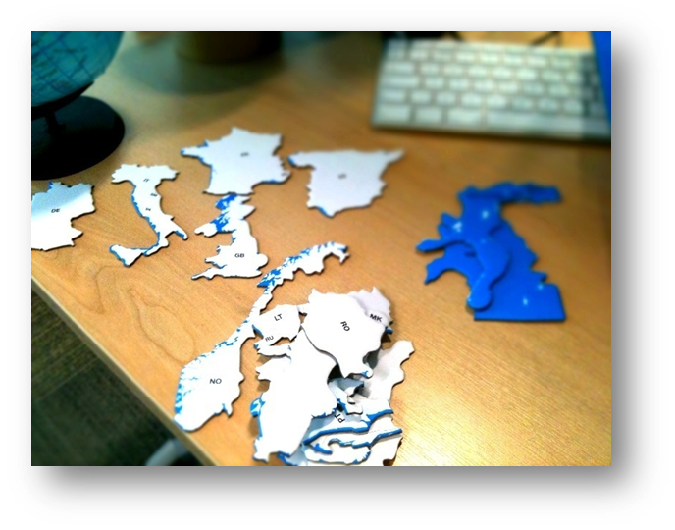
Overcoming barriers
New forms of long-term collaboration
Fostering and testing innovative approaches and science-policy cooperation
Gateways for scientific excellence, relevance and international cooperation
Strategic platforms for alignment

Slide 5
Joint Programming - principles
Three pillars
Shared vision: JPND countries engage voluntarily and on a variable-geometry
Reactive management structure
Common strategic research and innovation agenda

Slide 6
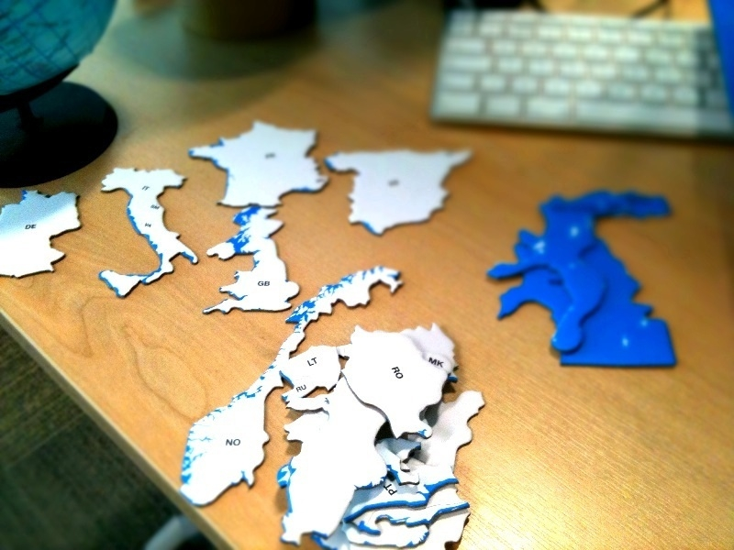
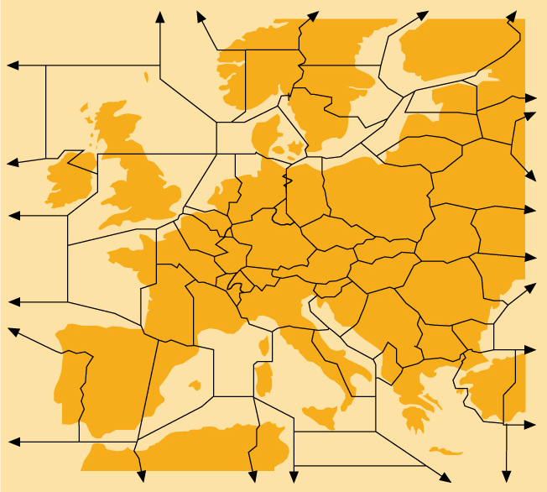
Aligning to defragment and enhance collaboration
STRATEGIC RESEARCH AND INNOVATION AGENDA
ALIGNMENT OF COUNTRIES
ON COMMON RESEARCH GOALS

Slide 7
Science crosses borders, not money
A Call Steering Committee composed of the participating agencies organises the evaluation according to international competitive standards
A Peer Review Panel composed of internationally recognised scientific experts evaluates the applications
A ranking list is provided
Each country delivers the budget(s) to participating national research team(s)

Slide 8
Implementing transnational joint calls
Since 2011 a total investment of more than €250M
Participation of the European Commission to the management of JPND and to 2 calls
More than 3 teams from more than 3 countries
Between 20 and 189 proposals per call
Between 153 and 1033 teams per call
More than 140 projects supported
Between €1M and €8M per project

Slide 9
Fostering public patient involvement
Acculturation of scientists and physicians to PPI
Training public, patients and patient advocates
Active participation of public and patients in research projects
Call topics encouraging public and patient involvement

Slide 10
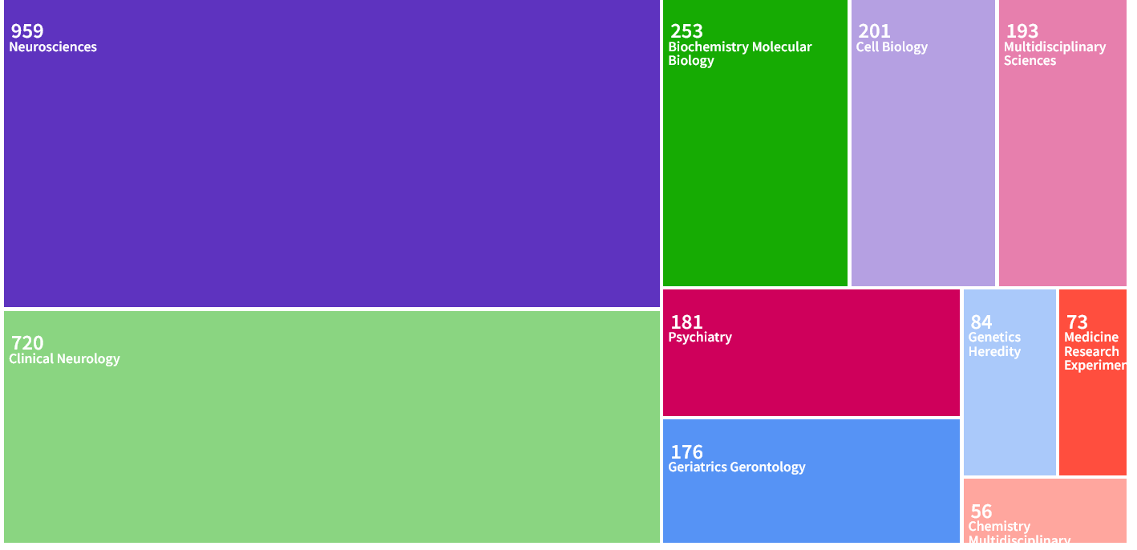
Number of JPND publications (WOS)
2,471 results from Web of Science Core Collection

Slide 11
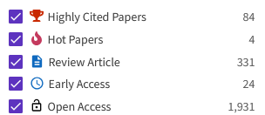
Number of JPND publications (WOS)
Cell 9
Science 6
Lancet 2
Lancet Neurology 10
Nature 2
Nature Neuroscience 7
Nature Ageing 5
Nature Medicine 5
Nature Genetics 5
Nature Human Behavior 3
Nature Microbiology 3
Nature Methods 1
Nature Protocols 1
Nature Reviews Neurology 11
Nature Reviews Neuroscience 3
Nature Reviews Endocrinology 2
Nature Reviews Genetics 1
Nature Reviews Immunology 1

Slide 12
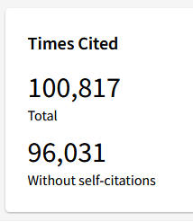
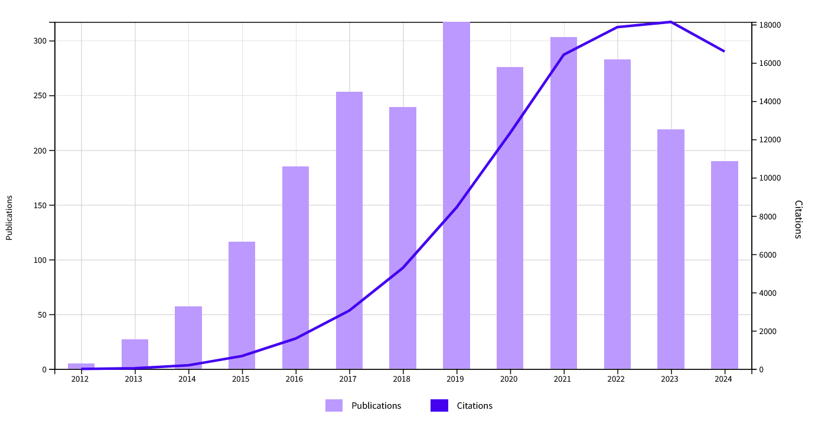
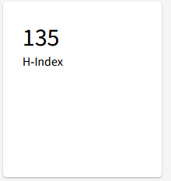
Citation impact (Clarivate analytics)

Slide 13
Program format
10:00 - 10:45
Registration: 45 min – Room T
10:45 - 11:35
Plenary: Opening (15min) + JPND Global impact (35 min) - Auditorium
10 min
11:45 - 13:15
Personalised Medicine – U/1
Imaging and Brain Stimulation U/2
Prediagnosis disturbances - A
13:15 - 14:15
Lunch Break: 60 min
DAY 1
14:15 - 15:45
Plenary: Panel discussion Translation of results (45min) + Panel discussion PPI + PI (45 minutes) - Auditorium
16:00 – 19:30
15 min
Poster sessions: 3,5h Room S
Networking + walking dinner
8:45 – 10:30
Plenary: AI and Data (45 min) + European infrastructres (45 min) - Auditorium
Short break: 30 min
Posters
Room S
11:00 – 12:30
Personalised Medicine
Imaging
Prediagnosis disturbances
12:30 – 13:30
Lunch Break: 60 min
13:30 – 15:00
Personalised Medicine
Imaging
Prediagnosis disturbances
DAY 2
15:15 – 16:10
15 min
Plenary: Poster prize (10 min) + Conclusions of JPND & Future BH (45 min) - Auditorium

Slide 14
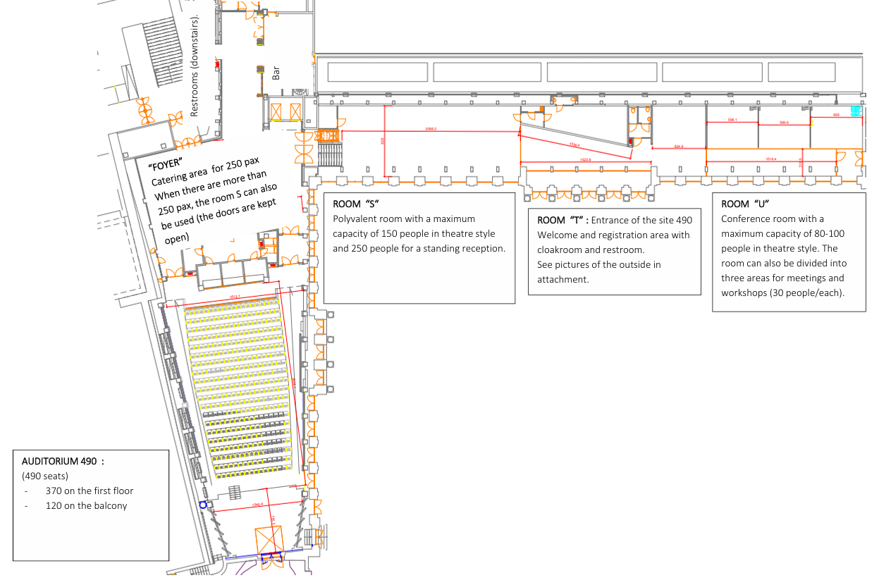
S
T
U1/2
A
Venue

Slide 15
Plenary sessions
Time | Topic | Duration | Format
DAY 1
10:45 - 11:00 | Opening JPND Chair | 15 min | Presentation
11:00 - 11:35 | Global impact of JPND program | 35 min | Presentation
14:15 - 15:00 | Translation of results | 45 min | Panel discussion
15:00 - 15:45 | PPI | 45 min | Panel discussion
DAY 2
9:00 - 9:45 | Big data and AI | 45 min | Presentation
9:45 - 10:30 | European infrastructures | 45 min | Round table
15:15 - 15:25 | Poster Prize | 10 min
15:25 - 16:10 | Conclusions | 20 min | Presentation

Slide 16
Practical information
Visit the posters in the foyer
Poster award ceremony at 5:20 pm
After the concluding remarks you are invited to a networking and refreshment opportunity in the foyer
Tweets about our symposium
#jpnd
#jpndsymposium2024
#neurodegeneration
@JPNDEurope

Slide 17
Acknowledgments
Rosalie Nelissen
Gabriëlle Lijten
Inge Sips
Sophie Habets
Cule Cucic
Karin Yeo
Pierre-Olivier Fernagut
Etienne Hirsch
Alexandra Rodrigues

